Slide 1

31th Jan 2026 Apache Kafka Meetup Pune

Slide 2

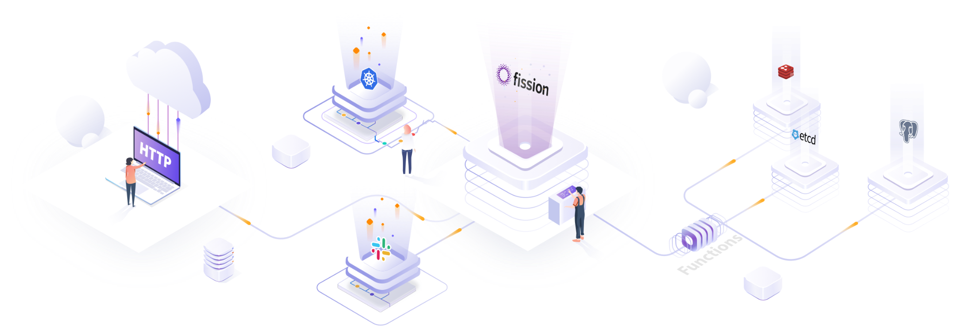

Building Event Driven Serverless Applications with Fission and Kafka
31th Jan 2026 | Apache Kafka Meetup Pune

Slide 3










Sanket Sudake
Principal Engineer
Improving Pune
Let’s Connect
Fission Maintainer / Contributor
fission.io
www.linkedin.com/in/sanketsudake
@SanketSudake
ssudake.com
fissionio
fission/fission
fission-serverless
2

Slide 4
Table of Functions :)
Fission Overview and Concepts
Function Execution Strategies
Kafka Integration Overview
Quick Demo with Fission Kafka
Use cases and examples
Q&A and Wrap up
fissionio
fission/fission
fission-serverless
3
Notes:
Abstract:
Fission is an open-source, serverless platform built on top of Kubernetes. It allows developers to create and deploy functions quickly without worrying about the underlying infrastructure.
Fission has integration with Messaging queues like Kafka, which enables event-driven architectures and real-time data processing.
Fission user also use Kafka as an event source to trigger functions based on messages published to Kafka topics and build complex workflows.
This talk will cover the following topics:
- Fission Overview and Concepts
- Function Execution Strategies
- Deep dive into Kafka integration
- A Quick demo of Fission with Kafka
- Real-world use cases and examples
- Q&A and Wrap up

Slide 5
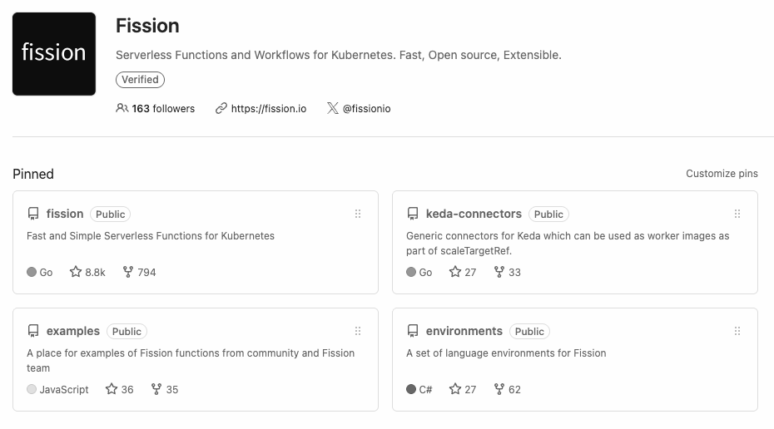
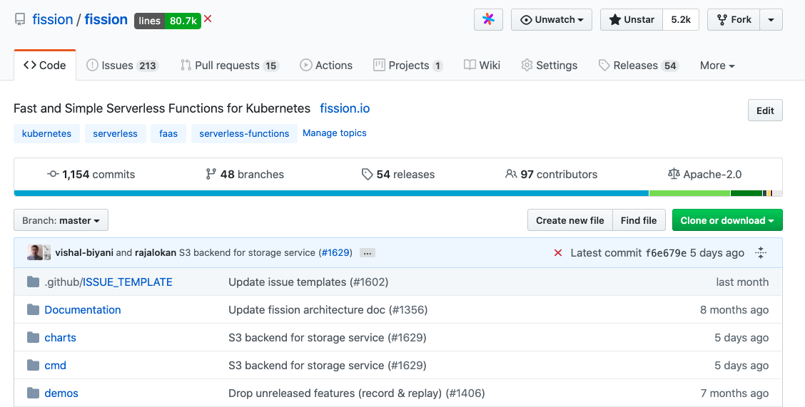

Fission on GitHub: Star & Show ❤️
You can Star & show ❤️ here
https://github.com/fission/fission
https://fission.io/docs/
https://fission.io/blog
fissionio
fission/fission
fission-serverless
4
Notes:
Fission has almost 8.8k Github stars
We have keda-connectors repo which contains integration with different messages queue providers like Kafka.
Environment, fission also provides environments for popular languages

Slide 6

Fission Concepts

Slide 7
Environment
NodeJS Env
Go Env
Base OS & Runtime Environment
Dependencies
Express, co, request, request-promise-native
Go Server
NodeJS Alpine
Ubuntu 18.04
Environment
Dependencies
OS + Runtime
fissionio
fission/fission
fission-serverless
Notes:
Environment
Base OS & Runtime Enviroment
Dependencies

Slide 8
Package
A “package” for user code
Source
Binary
User Code
Additional Dependencies
Compile time in case of compiled languages
Environment
Package
Dependencies
Dependencies
OS + Runtime
User Code
fissionio
fission/fission
fission-serverless
7

Slide 9


Builder Service
Compiles code from source to binary for compiled languages
For non-compiled - just packages them.
Can store in a PV or a S3 compatible object store
Storage Service
Environment
Package
Dependencies
Dependencies
Builder
Service
Compiles code & creates a package
OS + Runtime
User Code
fissionio
fission/fission
fission-serverless
8

Slide 10
Function
Runtime + Code
CPU & Memory
Scale parameters
Timeouts
Secrets and configmaps
Function Execution Strategies
Next slide..
Function
Runtime Config
PackageReference
Storage Service
Environment Reference
Environment
Package
Dependencies
Dependencies
Builder
Service
Compiles code & creates a package
OS + Runtime
User Code
fissionio
fission/fission
fission-serverless
9

Slide 11
HTTP & Time invocation
HTTP Trigger
For HTTP invocations
TimeTrigger
Cron based function invocation
Time Trigger
HTTP Trigger
Router
Service
Function
PoolManager
NewDeploy
Env
Env
Env
Env
Env
Code
Code
Executor Service
Runtime Config
PackageReference
Storage Service
Environment Reference
Environment
Package
Dependencies
Dependencies
Builder
Service
Compiles code & creates a package
OS + Runtime
User Code
fissionio
fission/fission
fission-serverless
10

Slide 12
“Hello World” - Fission version
$ fission env create --name nodejs --image fission/node-env
$ fission fn create --name hellojs --env nodejs --code https://raw.githubusercontent.com/fission/fission/master/examples/nodejs/hello.js
$ fission function test --name hello
Hello, world! $ fission route create --function hello --url /hello $ curl http://router.fission/hello
fissionio
fission/fission
fission-serverless
11

Slide 13
MQ invocation
AzureQS Trigger
NATS Trigger
Kafka Trigger
MQTrigger
Service
MQ Trigger - Current Support
Kafka
NATS
Azure Queue Storage
RabbitMQ
Redis
AWS SQS
GCP PubSub
Time Trigger
HTTP Trigger
Router
Service
Function
PoolManager
NewDeploy
Env
Env
Env
Env
Env
Code
Code
Executor Service
Runtime Config
PackageReference
Storage Service
Environment Reference
Environment
Package
Dependencies
Dependencies
Builder
Service
Compiles code & creates a package
OS + Runtime
User Code
fissionio
fission/fission
fission-serverless
12

Slide 14









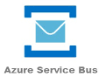




Fission <> Keda Integration
Event Driven Autoscaling
Vendor Agnostic
Built-in Scalars
https://github.com/kedacore/keda
fissionio
fission/fission
fission-serverless
13

Slide 15
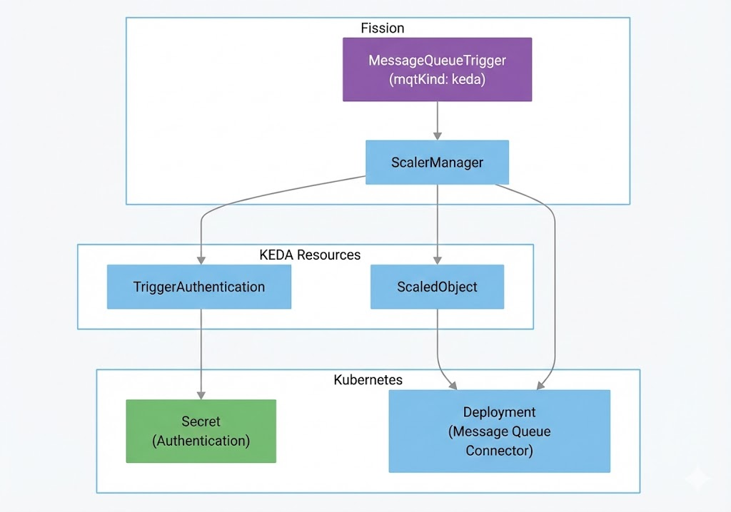
Creating Keda Connector
fissionio
fission/fission
fission-serverless
14

Slide 16
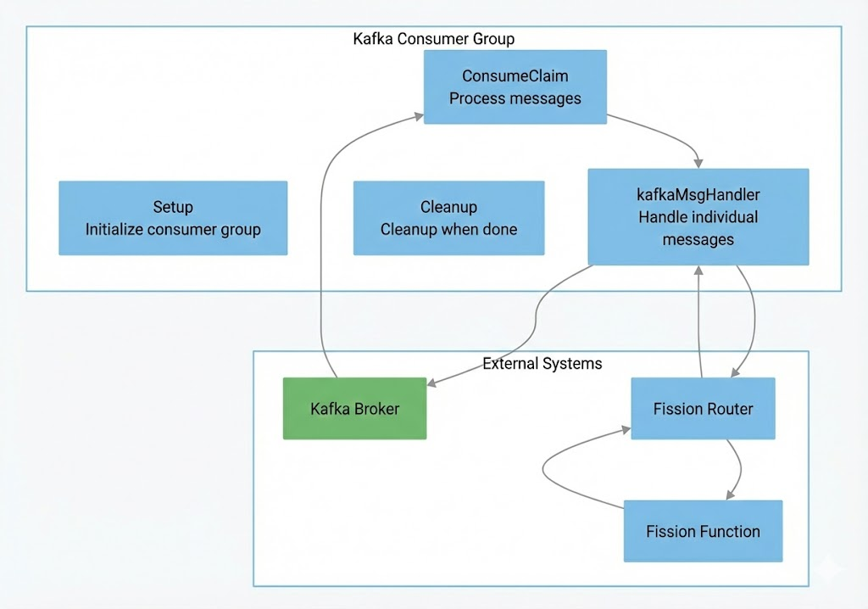
Kafka Keda Connector
fissionio
fission/fission
fission-serverless
15

Slide 17
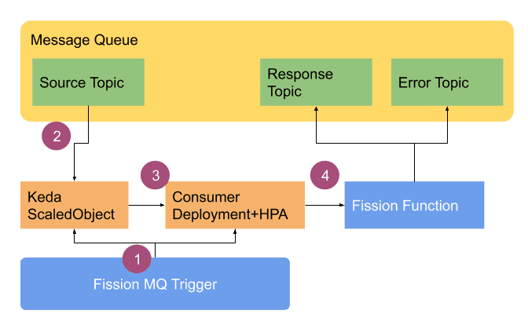
MQ Trigger Flow
fission mqt create --name kafka-trigger \
--function hello \
--mqtype kafka \
--topic my-topic \
--mqtkind keda \
--resptopic response-topic \
--errortopic error-topic \
--maxretries 3 \
--metadata bootstrapServers=kafka-broker:9092 \
--metadata consumerGroup=fission-group \
--secret kafka-secret
fissionio
fission/fission
fission-serverless
16

Slide 18
Metrics / Monitoring
Metric | Description
fission_mqt_subscriptions | Total number of active subscriptions
fission_mqt_messages_processed_total | Total number of messages processed
fission_mqt_message_lag | Number of messages waiting to be processed per topic/partition
fission_mqt_status | Status of triggers (1 if processing, 0 otherwise)
fission_mqt_inprocess | Total number of MQTs in active processing
fissionio
fission/fission
fission-serverless
17

Slide 19
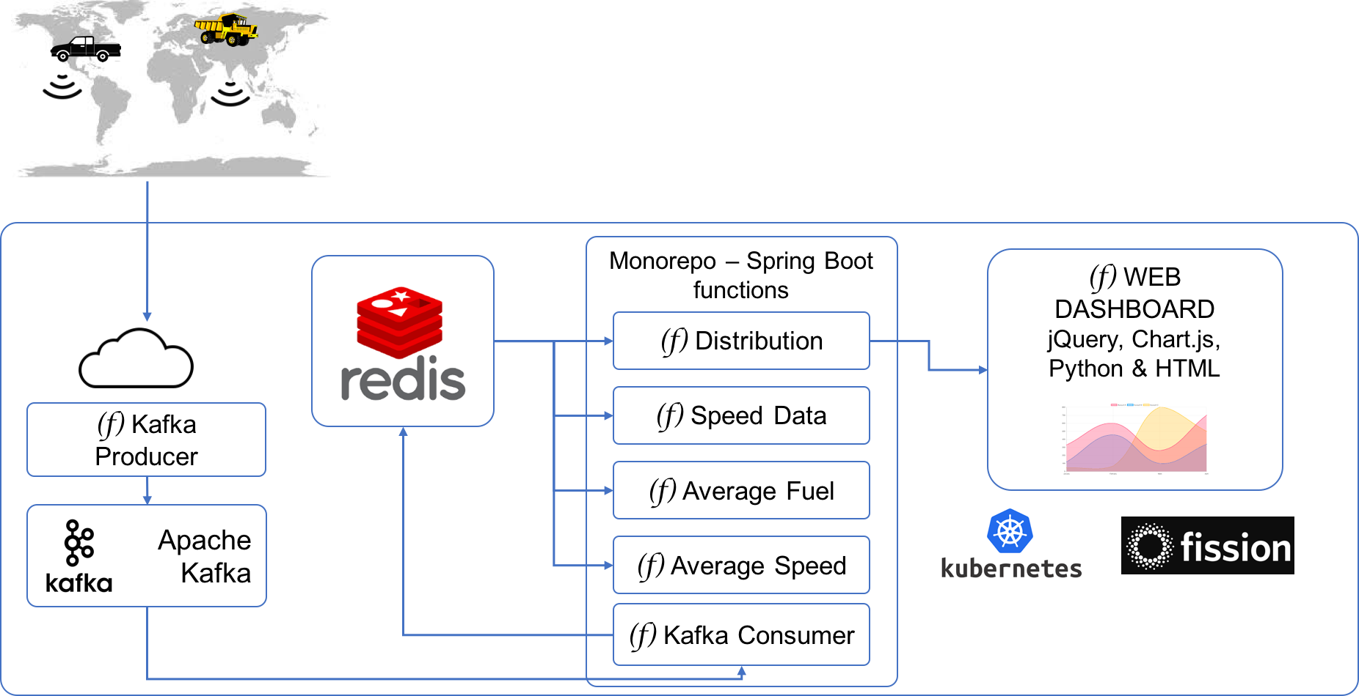
Example usecase
6 functions covering
A function for UI
Function for MQT
Reading/Writing to DB
Multiple Languages
https://github.com/fission/fission-kafka-sample
fissionio
fission/fission
fission-serverless
18

Slide 20
Example usecase
6 functions covering
A function for UI
Function for MQT
Reading/Writing to DB
Multiple Languages
https://github.com/fission/fission-kafka-sample
fissionio
fission/fission
fission-serverless
18

Slide 21
Demo

Slide 22
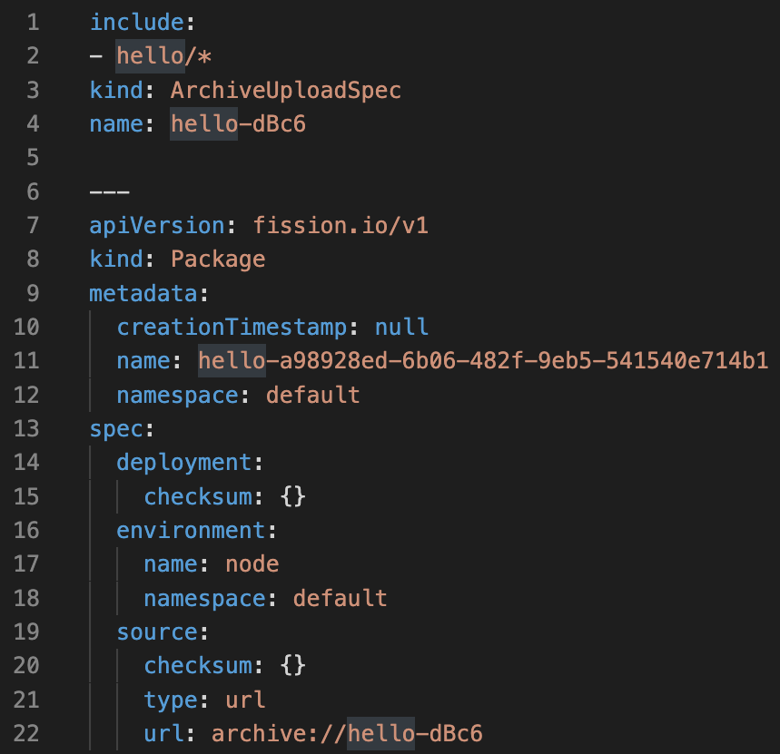
Fission specs
For better source control, CI/CD
You can apply with Kubectl too!
fission spec validate; fission spec apply
GitHub Action for Fission : https://github.com/fission/action
fissionio
fission/fission
fission-serverless
14

Slide 23
Start open source contribution journey
Start here https://fission.io/docs/contributing/
Ask Questions on Slack
Work with a friendly and helpful community
fissionio
fission/fission
fission-serverless
12

Slide 24
Questions?

Slide 25



Thank You
fissionio
fission/fission
fission-serverless

Slide 26
Execution Strategy: PoolManager
PoolManager
A pool of “warm” pods (Without the code)
One Pool per runtime/environment
No user code - code is loaded lazily
PoolManager
Env
Env
Env
Executor Service
Function
Runtime Config
PackageReference
Storage Service
Environment Reference
Environment
Package
Dependencies
Dependencies
Builder
Service
Compiles code & creates a package
OS + Runtime
User Code
fissionio
fission/fission
fission-serverless
18

Slide 27
Execution Strategy: PoolManager
Small latency in request path
PoolManager
On request - one pod is taken out of “pool”
Code is loaded and initialized (Called Specialization)
Response is returned
Pool is replenished
HTTP Request
Env
PoolManager
Code
Env
Env
Env
Executor Service
Function
Runtime Config
PackageReference
Storage Service
Environment Reference
Environment
Package
Dependencies
Dependencies
Builder
Service
Compiles code & creates a package
OS + Runtime
User Code
fissionio
fission/fission
fission-serverless
19

Slide 28

Execution Strategy: PoolManager
PoolManager
If more requests come for same pod - they are served
If no requests - the specialized pod is cleaned up
Env
TimeOut - Cleanup
PoolManager
Code
Env
Env
Env
Executor Service
Function
Runtime Config
PackageReference
Storage Service
Environment Reference
Environment
Package
Dependencies
Dependencies
Builder
Service
Compiles code & creates a package
OS + Runtime
User Code
fissionio
fission/fission
fission-serverless
20

Slide 29
Execution Strategy: NewDeploy
NewDeploy executor
“Specialization” done at initialization only
No lazy loading
Can be scaled by a Kubernetes HPA
NewDeploy
Env
Env
Code
Code
Executor Service
Function
Runtime Config
PackageReference
Storage Service
Environment Reference
Environment
Package
Dependencies
Dependencies
Builder
Service
Compiles code & creates a package
OS + Runtime
User Code
fissionio
fission/fission
fission-serverless
21

Slide 30
Execution Strategy: NewDeploy
NO latency in request path
NewDeploy executor
“Specialization” done at initialization only
No lazy loading
Can be scaled by a Kubernetes HPA
HTTP Request
NewDeploy
Env
Env
Code
Code
Executor Service
Function
Runtime Config
PackageReference
Storage Service
Environment Reference
Environment
Package
Dependencies
Dependencies
Builder
Service
Compiles code & creates a package
OS + Runtime
User Code
fissionio
fission/fission
fission-serverless
22

Slide 31
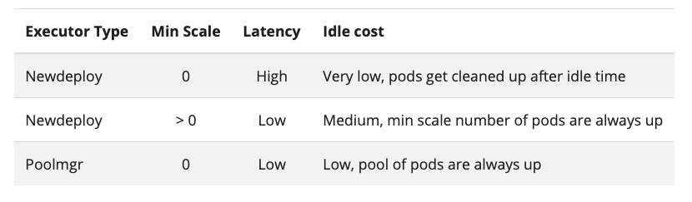
PoolManager vs. NewDeploy
fissionio
fission/fission
fission-serverless
23

Slide 32
PodSpec: Functions on Steroids!
Taints & Tolerations
Volume mounting on functions
Init Containers
Sidecars
Custom Scheduler
Security Context
Node Selector
Readiness Gates
https://blog.fission.io/fission_pod_specs/
fissionio
fission/fission
fission-serverless
3

Slide 33
Exciting new features coming soon..
Debug breakpoint support
Docker Container support
Updated Java environment with JDK 11,13,14 support
In browser development
Multi Tenancy implementation details
And many more..
fissionio
fission/fission
fission-serverless
4

